Slide 1
ToyBees Billing & Recommendation Sytem
Team Name : No-Brainers
Team Members : Shreyaa Sridhar
Navya Battu
Harika Adivanne
Sulochana Rani Mulpuri

Slide 2
Problem Statement
Create a Billing and Recommendation System for a toy store where the price range of items lies between 1 penny to 99 cents and the shop has a defined payment procedure which is $1. In other words, a single receipt can amount to a maximum of $1.

Slide 3
Features
The application calculates the amount to be returned.
As the cashier, return the remaining amount in coins. You also need to implement how many coins of 1 cent(penny),5 cent(nickel),10 cent (dime),25 cents (quarter),50 cents (half a Dollar) values the cashier needs to return.
Furthermore, provide a recommendation system based on 3 buckets/groups, characterized based on age groups. For examples, bucket 1 can contain toys suitable for kids in the age group of 0-4 years old. Bucket 2 can contain toys suitable for kids in the age group of 5 – 10 years old. Bucket 3 can contain toys suitable for kids in the age group of 11-15 years old.

Slide 4
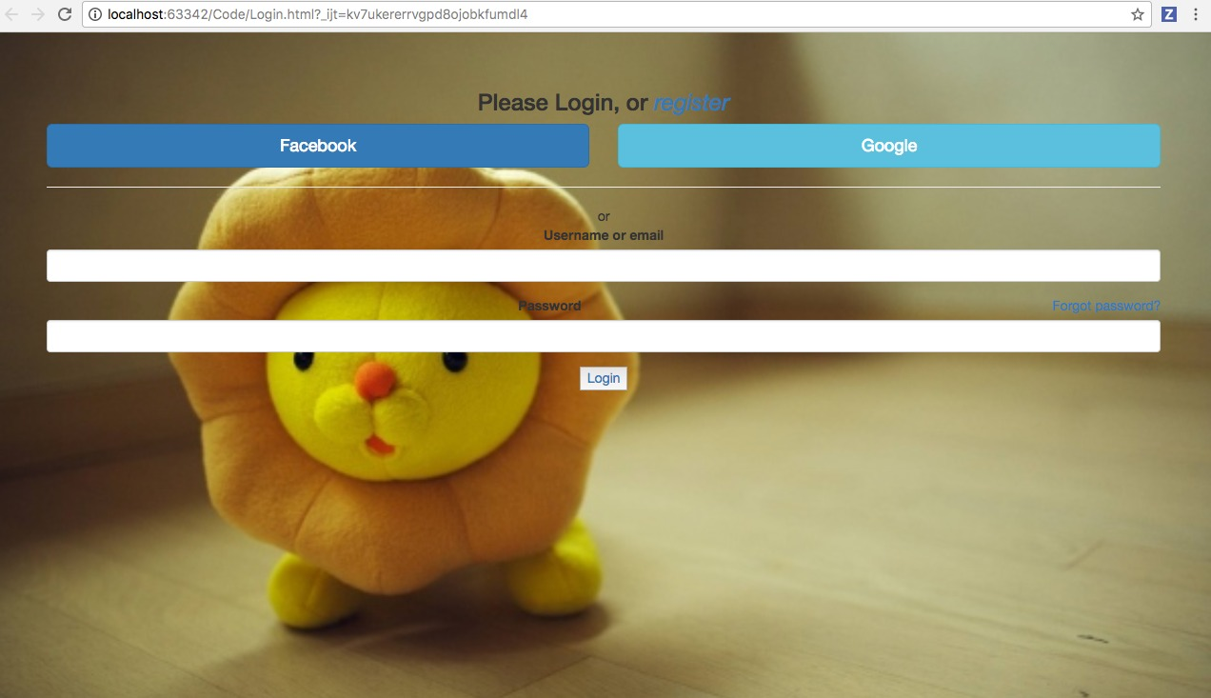
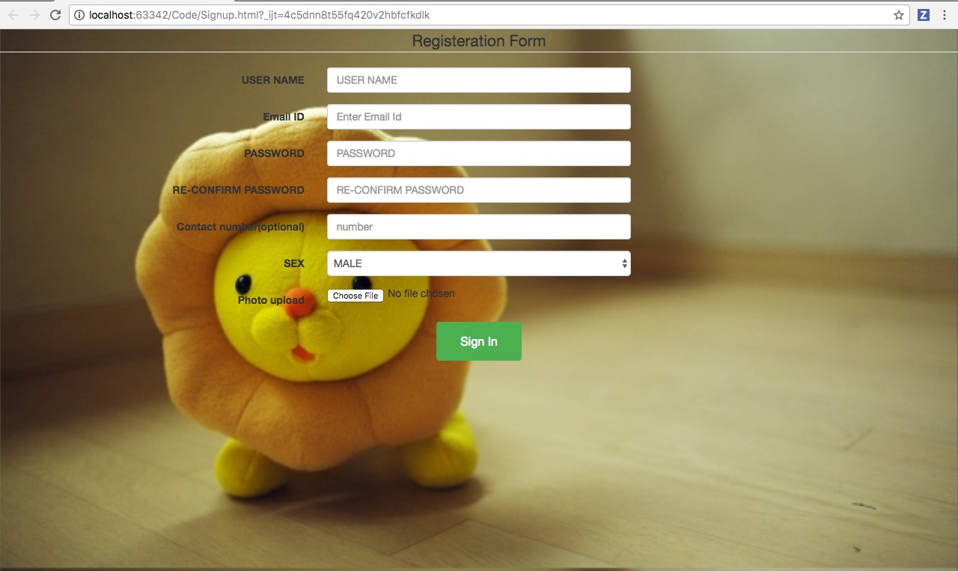
Login & Registration

Slide 5
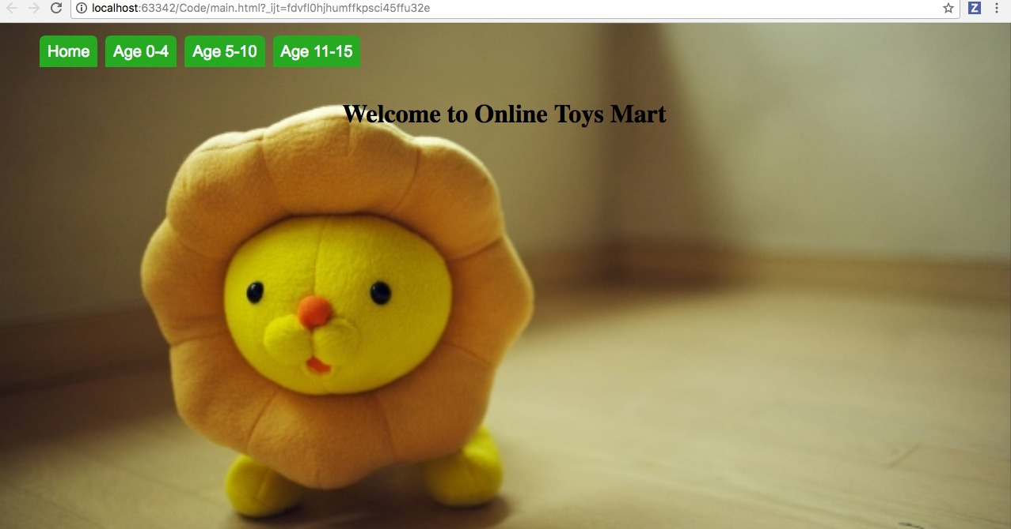
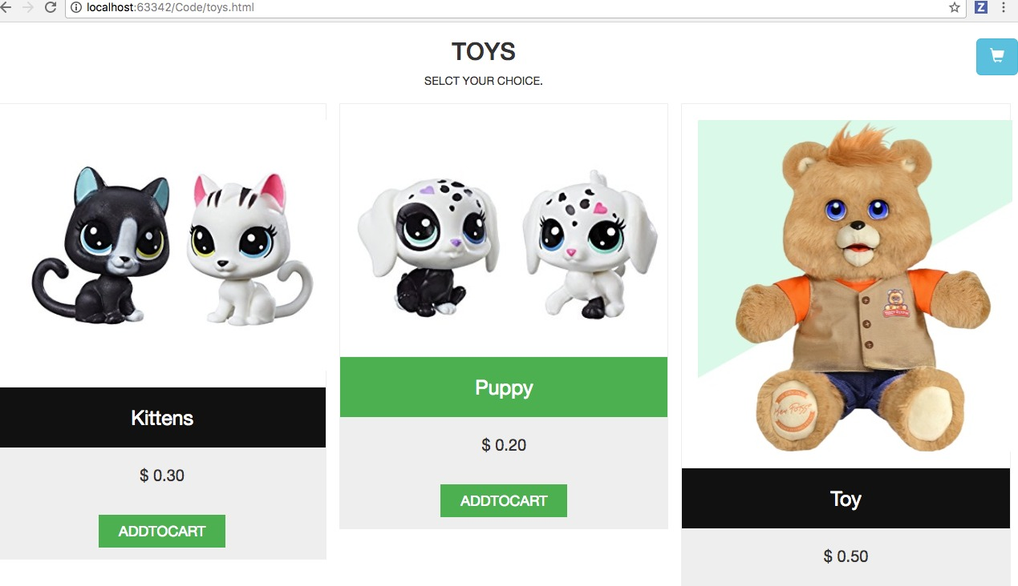
Online Toy Store

Slide 6
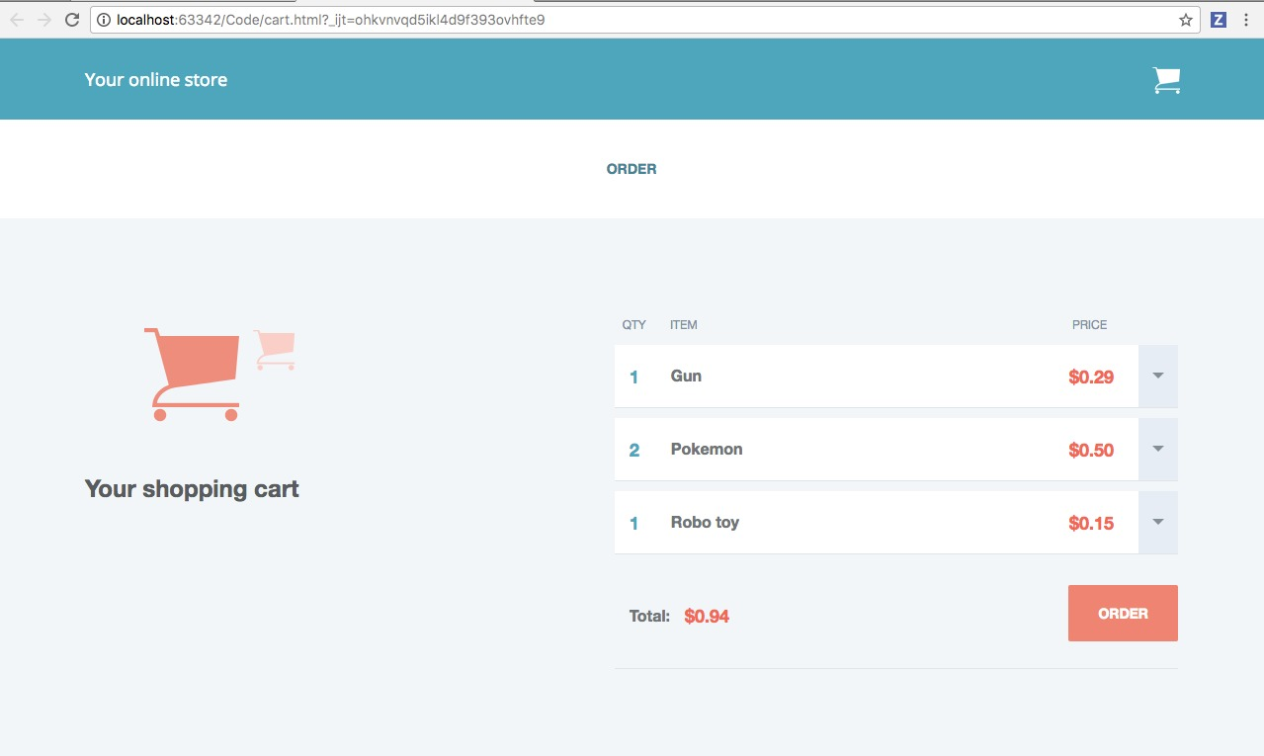
Cart

Slide 7
Thank You

